Slide 1
Presented By:
YASH JAISWAL

Slide 2
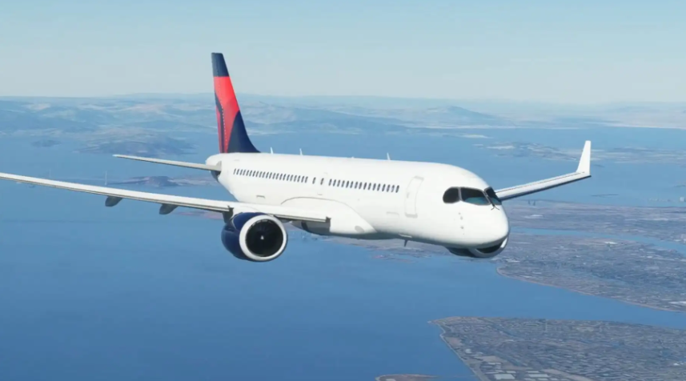
FLIGHT

Slide 3
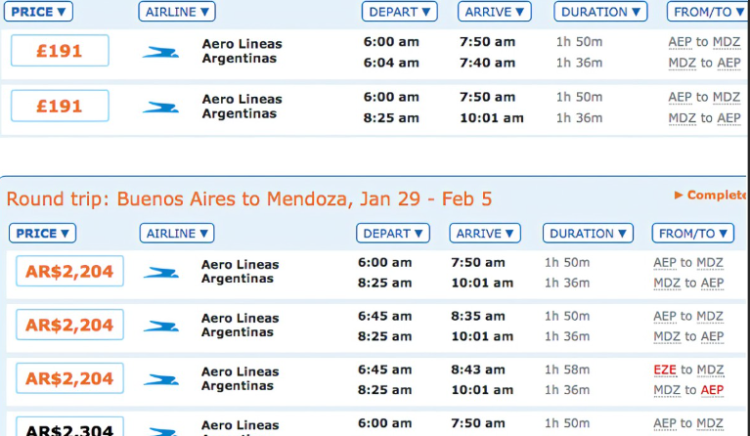
FLIGHT PRICE SCRAPE DATA

Slide 4
FLIGHT PRICE PREDICTION
1) Flight ticket
2) Value for Money
3) Flight ticket Repurchase
4) Service quality

Slide 5
INTRODUCTION
1) Key of Purchase
2) Collect data
3) Flight fares
4) Success of Flight Ticket

Slide 6
PROBLEM STATEMENT
Anyone who has booked a flight ticket knows how unexpectedly the prices vary. The cheapest available ticket on a given flight gets more and less expensive over time. This usually happens as an attempt to maximize revenue based on –
1. Time of purchase patterns (making sure last-minute purchases are expensive) 2. Keeping the flight as full as they want it (raising prices on a flight which is filling up in order to reduce sales and hold back inventory for those expensive last-minute expensive purchases)
So, you have to work on a project where you collect data of flight fares with other features and work to make a model to predict fares of flights.

Slide 7
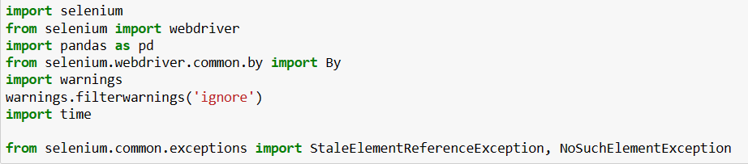
Data Scraping Libraries

Slide 8
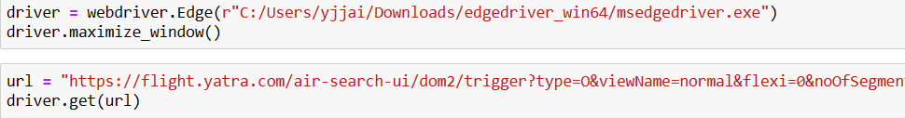
Web Driver Open

Slide 9
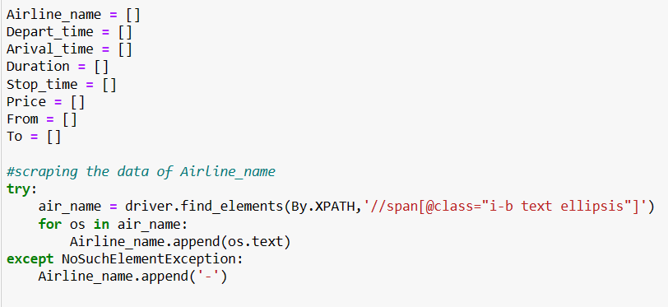
Data Collection

Slide 10
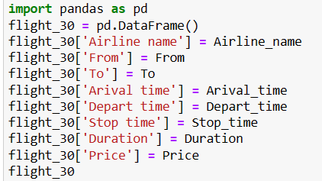
Data Collection Data Frame

Slide 11
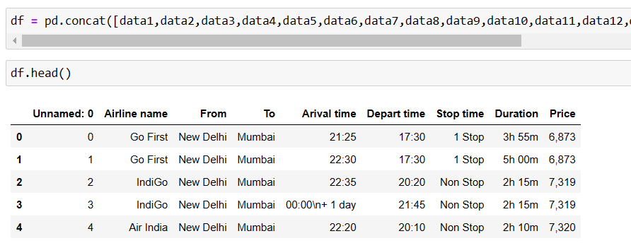
ALL DATASET TO JOIN

Slide 12
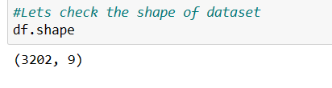
DATA SHAPE

Slide 13
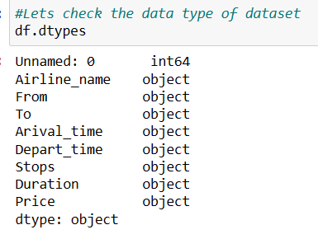
DATA TYPES

Slide 14
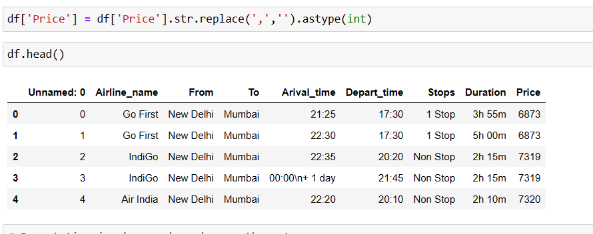
Object type convert to int

Slide 15
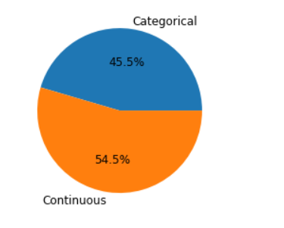
% Wise Categorical data and Continuous Data

Slide 16
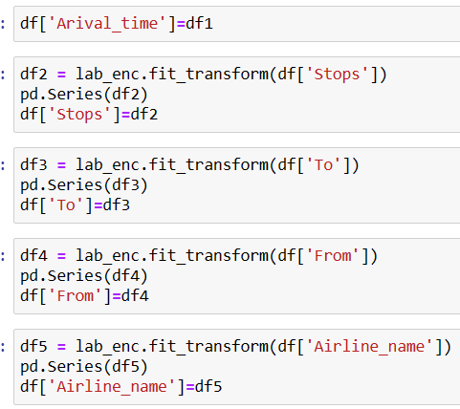
Binary Data to Convert Numerical

Slide 17
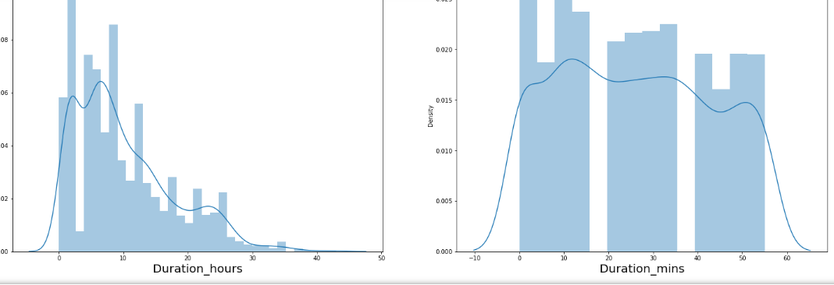
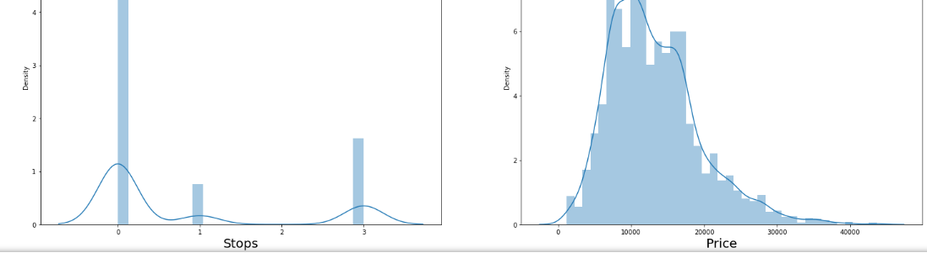
Skewness

Slide 18
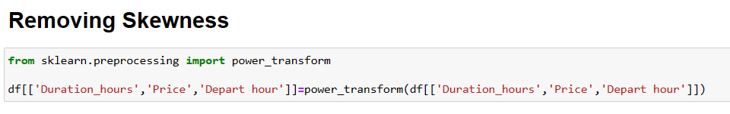
Removing Skewness

Slide 19
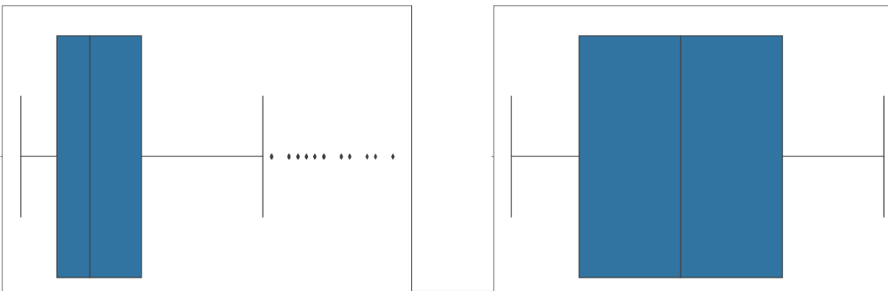
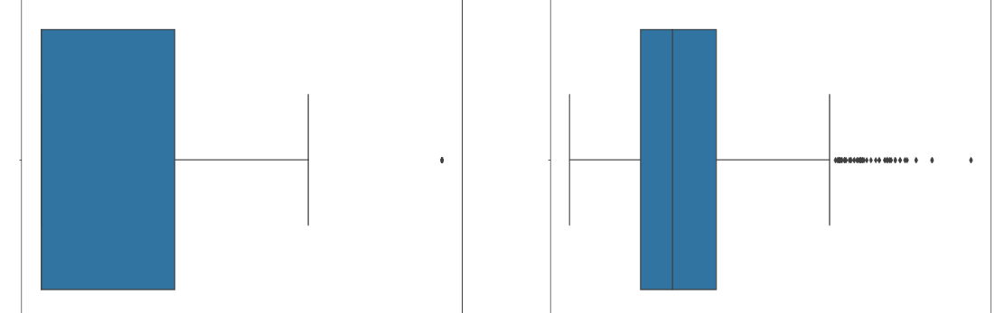
BOXPLOT

Slide 20
OUTLIERS
DURATION HOUR
PRICE

Slide 21
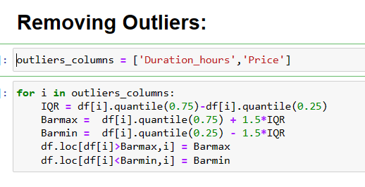
Removing Outliers

Slide 22
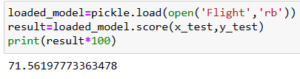
CONCLUSION

Slide 23
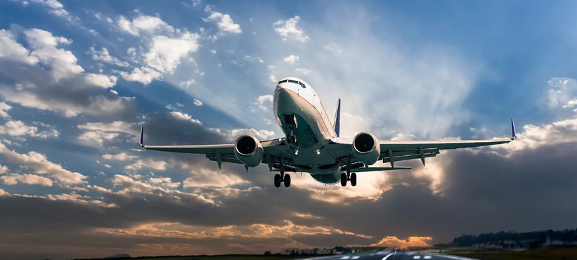
THANK YOU

